Slide 1
Module 4: The vacillating Giant
Talk | Title | Time Period | Date of Talk
23 | USA and the 20th Century | 1898-1900 | September 2nd
24 | The Progressive era | 1900-1916 | September 16th
25 | USA and world War One | 1914-1918 | October 21st
26 | The retreat to “normalcy’ | 1918-1920 | November 4th
27 | The Roaring Twenties | 1921-1929 | November 18th
28 | Great Depression and New Deal | 1929-1938 | December 2nd
29 | USA and the 1930’s world | 1932-1939 | December 16th

Slide 2
American History
1
Talk 29: Great Depression and New Deal (1929-1938)
Part three

Slide 3
The opposition ….left and right

Slide 4
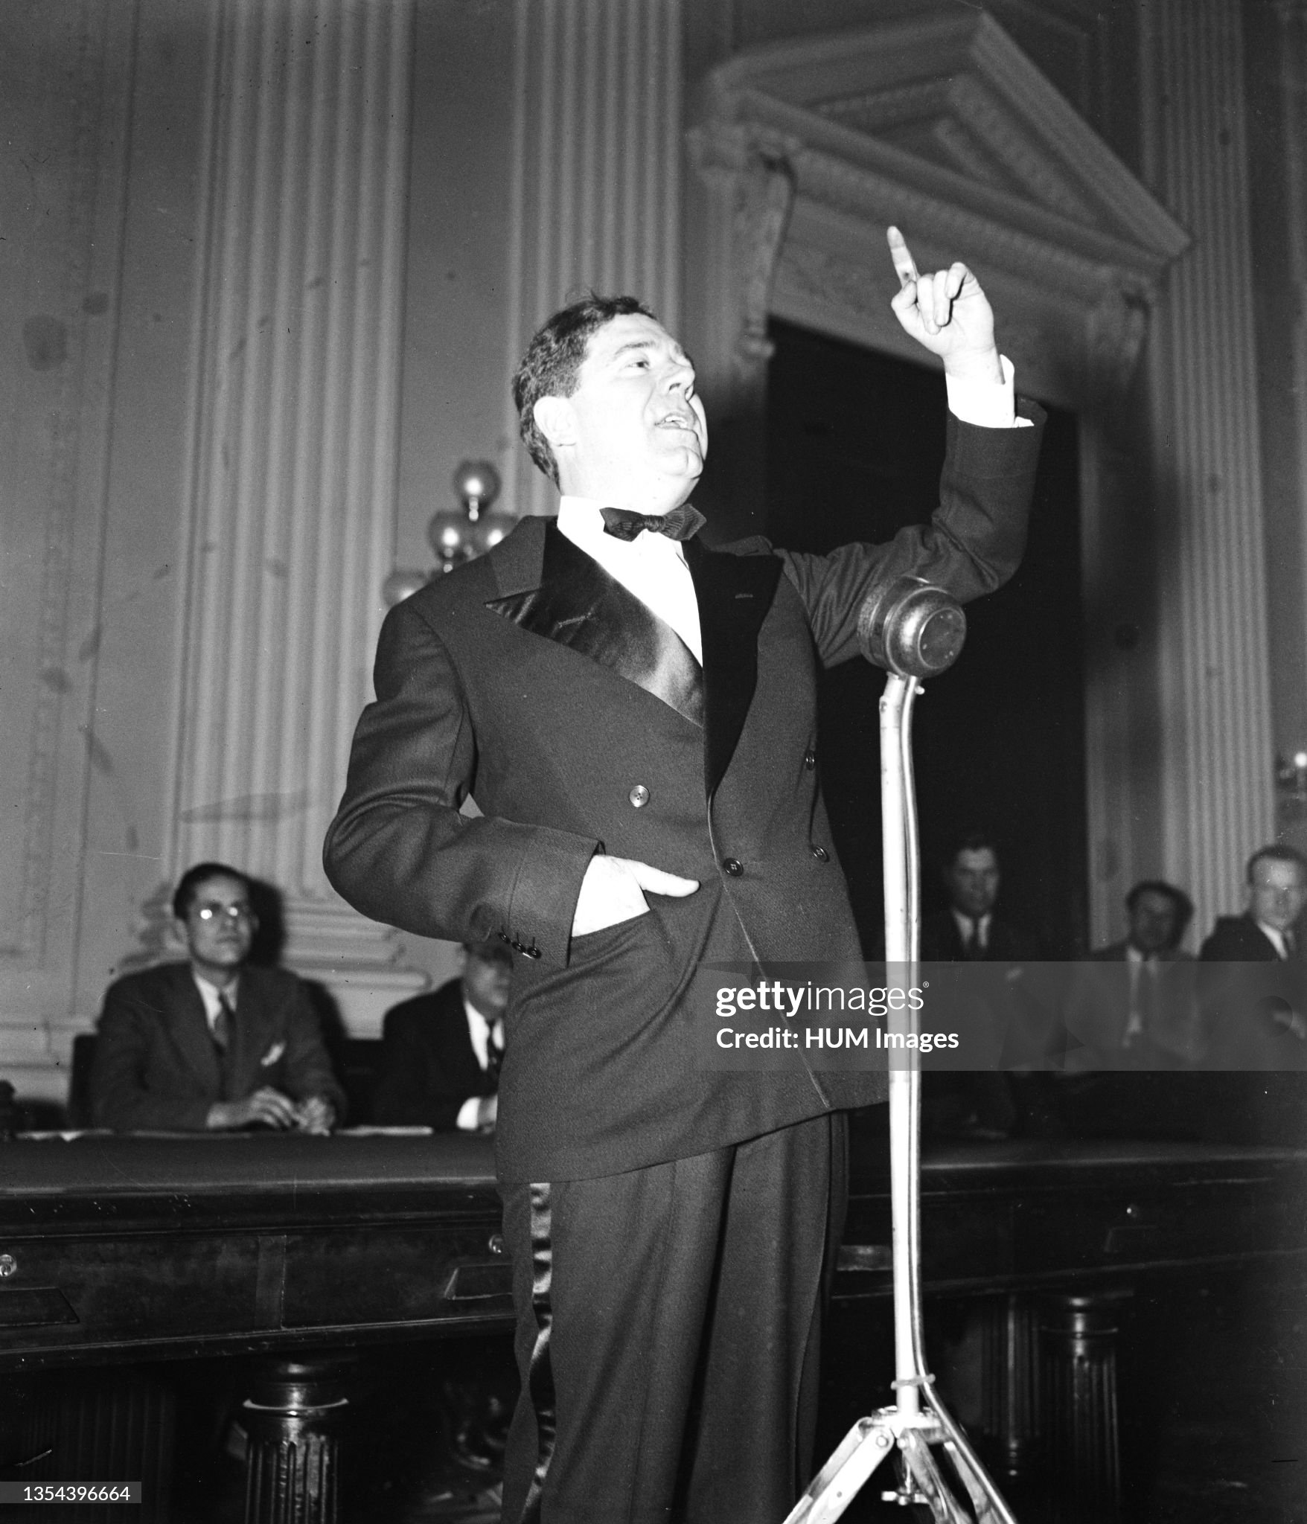
Huey Long …the Trump of the Left
Huey Long (1938
Louisiana Governor
(1928-1932), Senator
1932-1935
Impoverished family
..travelling salesman
..law school
..state politics
Committed to poor
..all poor (white/black)
..white supremacist
..anti corporations
…wins class actions
“Every man a king,
But no one wears
The crown”

Slide 5
“Share the Wealth Plan”
Dictator of Louisiana 1928-1932 (“I am the constitution”)
Public works programmes, school books, roads, hospitals
Use of patronage & intimidations (incl.kidnapping), exortion, kidnapping
As Senator
Supports New Deal not radical enough.. Protecting the rich. Side-lined
Runs Louisiana remotely….bans local opposition, crime to criticise
“Share the Wealth Plan“
Cap fortunes at $100 million, income at $1 million
$5,000 grant to everyone…plus guaranteed annual income
Considers running against FDR 1936
Assassinated 1935….son of judge subject to gerrymandering…
……………”I can’t die now I have so much to do”

Slide 6
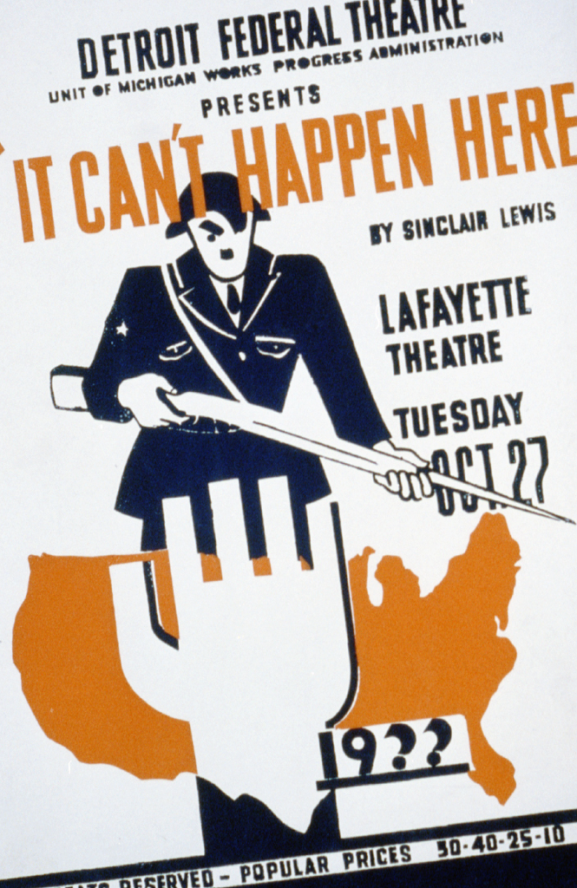

Slide 7
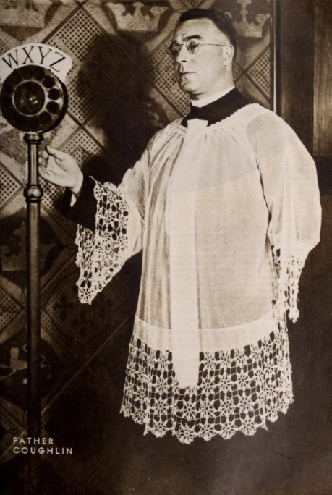
Father McLaughlin: “the Radio Priest”
Father McLaughlin 1938
Canadian Catholic
Migrates to Detroit
Radio Show….30 million listener
Support FDR 1933-1936
….anti rich, pro workingman
…anti Klan,
..anti Communism/ anti capitalsi
Rejects FDR 1936
….Jewish conspiracy
….Anti Semitic Newspaper
…supports Nazi Party
Disowned by church, silent during war
…..repents before death 1974

Slide 8
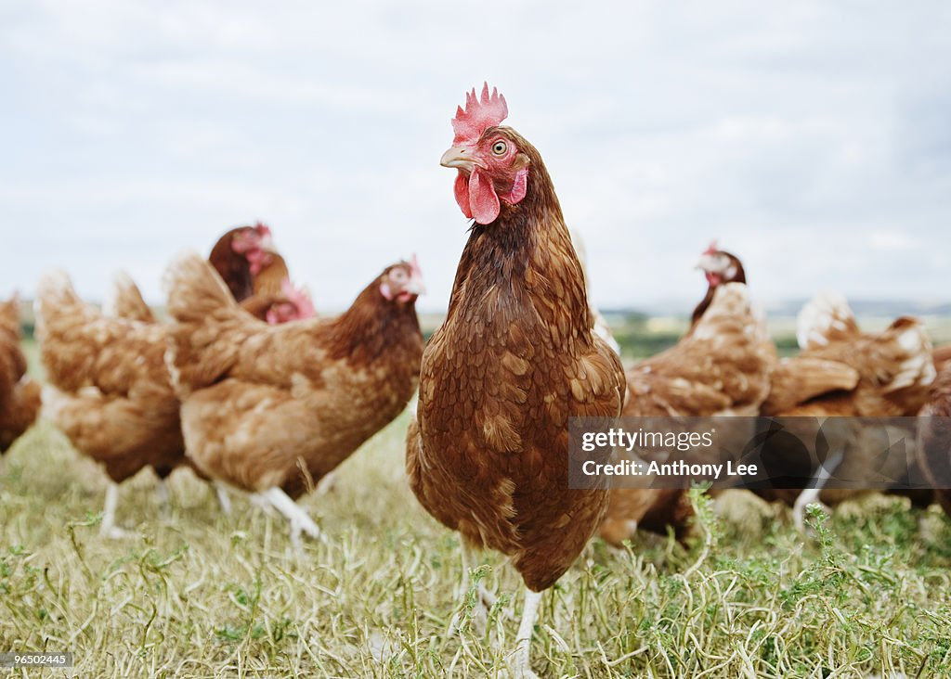
The New Deal’s Biggest Threat !

Slide 9
”Sick Chicken Case” ( Schechter Poultry vs USA)
Scheckler Brothers
Jewish poultry farmers New York State
Required by NIRA to comply with regulations sorting & pricing sale of live chickens
Violate law…sued…appeal to Supreme Court 1935
Ruling:
Government over-reach of power vs states and industry
NRA “Unconstitutional”

Slide 10
FDR vs Supreme Court
Chief Justice Brandeis: “This is the end of this business of centralization, and I want you to go back and tell the president that we’re not going to let this government centralize everything. It’s come to an end.”
FDR Response: “horse and buggy” Court…threatens to “pack Court
Attack on New Deal Programmes
Threatens to “pack court”
Court “enemy of the People”
Court backs down:
…continued conflict on Constitution continues….today

Slide 11
Re-election and 2nd New Deal

Slide 12
Re-election and Second New Deal
Confidence returned,
........GPD increases 50% from 1933, unemployment drops from 25% to 15%
FDR dissatisfied …wants more Social Change….and balanced budget
Positions himself as defender of working man….
(The rich) are unanimous in their hate for me — and I welcome their hatred."
Wins re-election in 1936: landslide 60%
Second New Deal 1936….a muddle
Boosting economy: Social Security + Work Progress Administration
Shrinking economy/ reducing debt..higher taxes + regulations

Slide 13
WPA ….1936-1943
Investment in direct government employment
7% of GDP , 3 million employed directly by government
Infrastructure expansion 10,000 bridges, 600,000 miles of roads road, bridges, parks,
Pay below industry standard…employer of last resort
“Federal Project One”: public investment in arts, libraries, theatres, painting, culture…”art for everyone”
Compromises….to retain “white” support….White preference
….keeping the “Solid South” Democratic
Federal Government becomes US largest employer
…..offsets higher taxes & unemployment rise to 20%.. falls back to 15%

Slide 14
Selling the New Deal

Slide 15
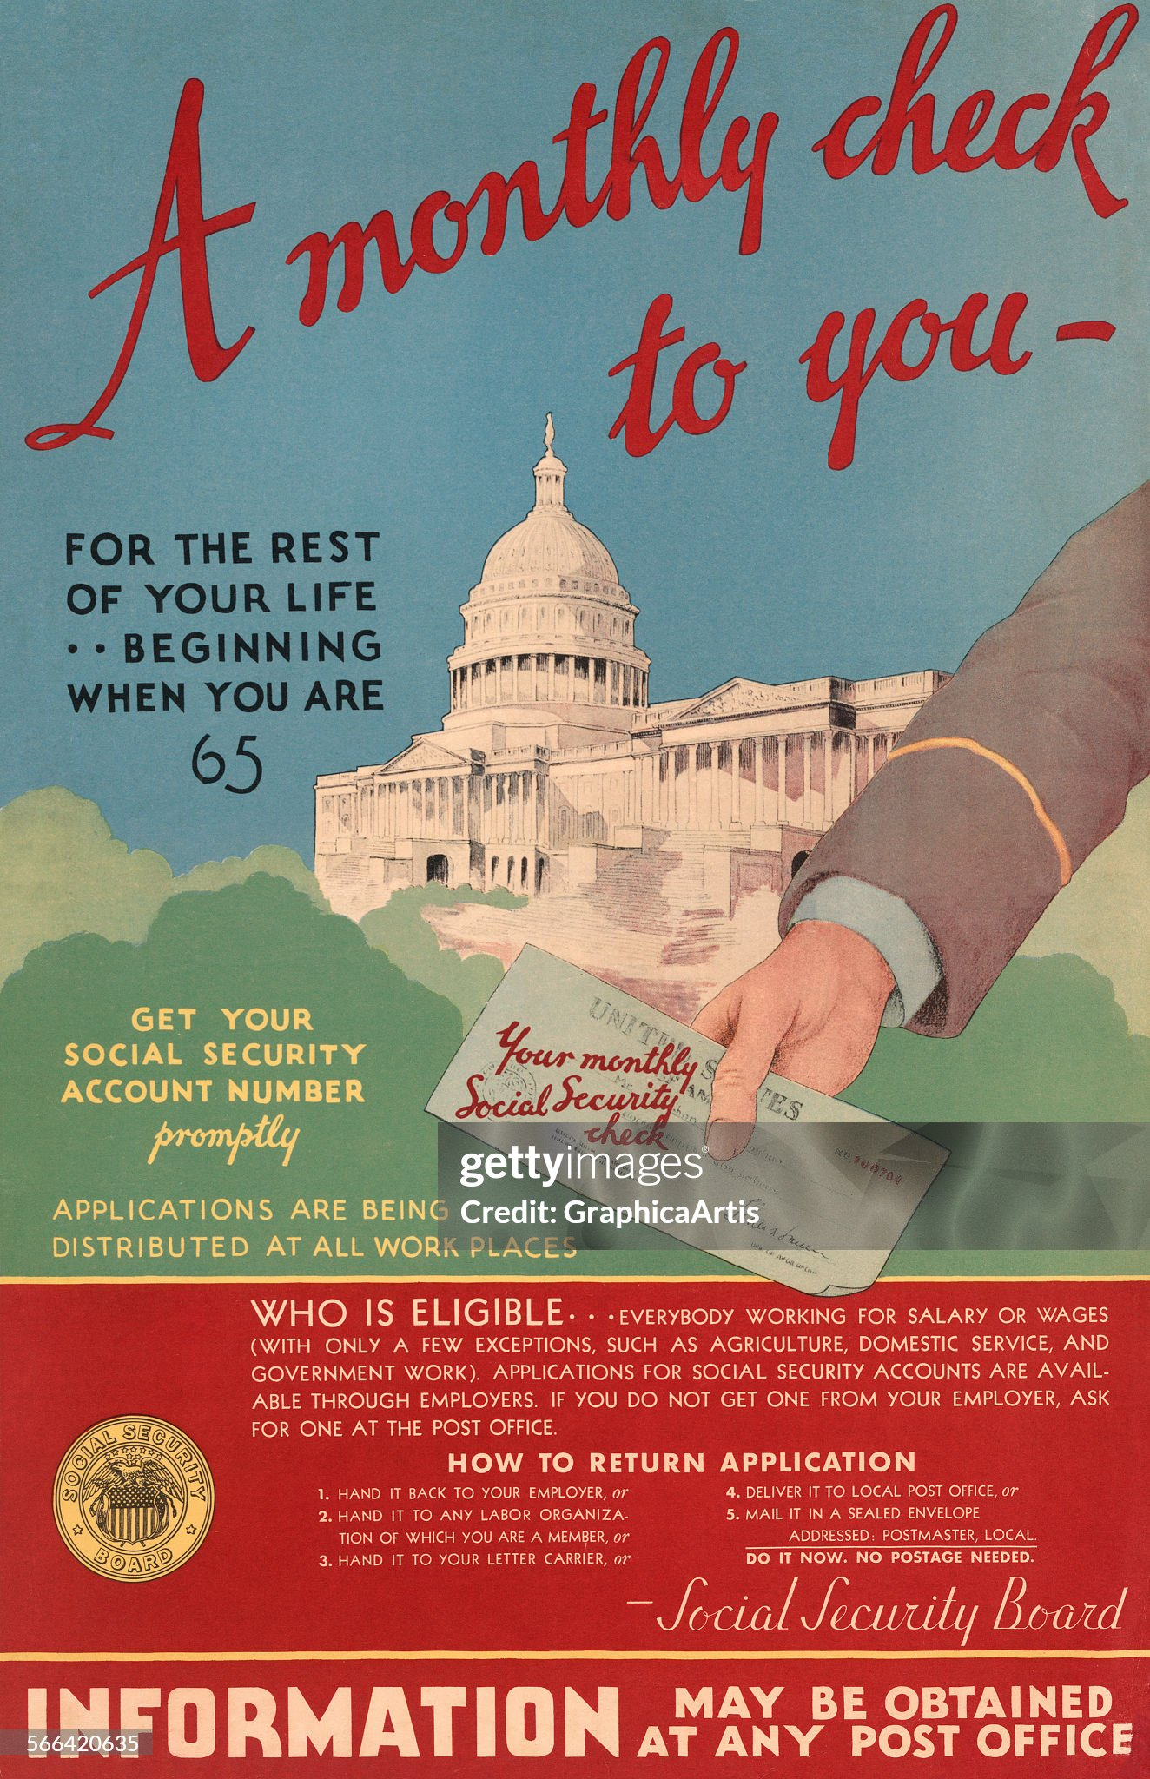
Social Security ( Germany 1880, UK 1907)

Slide 16
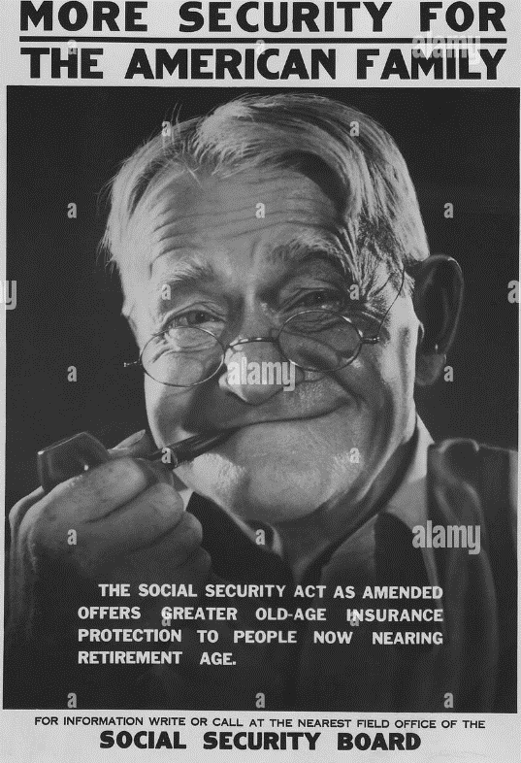

Slide 17
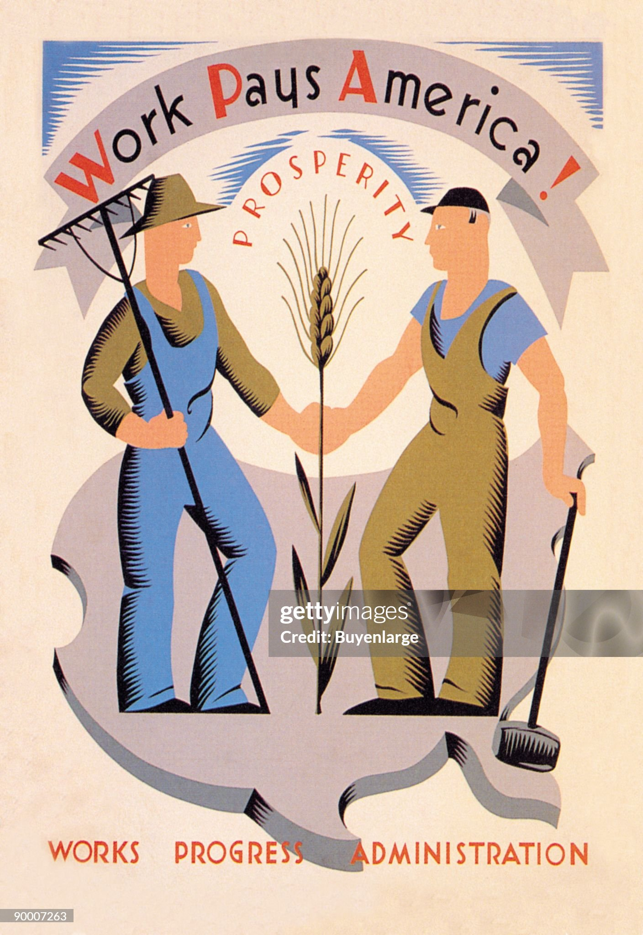
Work Progress Administration

Slide 18
WPA : Artists employed by Government

Slide 20
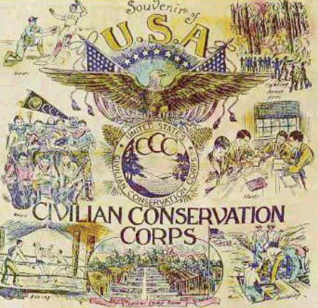
CCC Propaganda

Slide 21
Eleanor Roosevelt

Slide 22
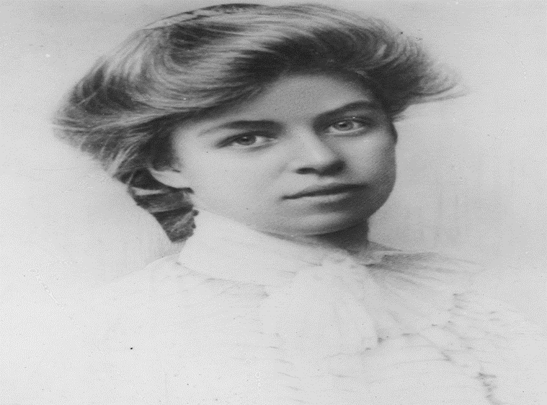
Eleanor Roosevelt (1884 -1962) …”First Lady” 1932-1945
Wealthy family…Father Teddy Roosevelt’s brother,
Eleanor aged 14
Unhappy childhood
….mother ignores. "ugly duckling”
… too serious child
…traumatised by shipwreck
Privately tutored, lonely
…Mother dies from diphtheria
…Father alcoholic/suicide/stroke
..privately tutored uncle’s home
Sent to England 1899-1902 Madame Souvestre..feminist
…happy time…educated in
Progressive thought

Slide 23
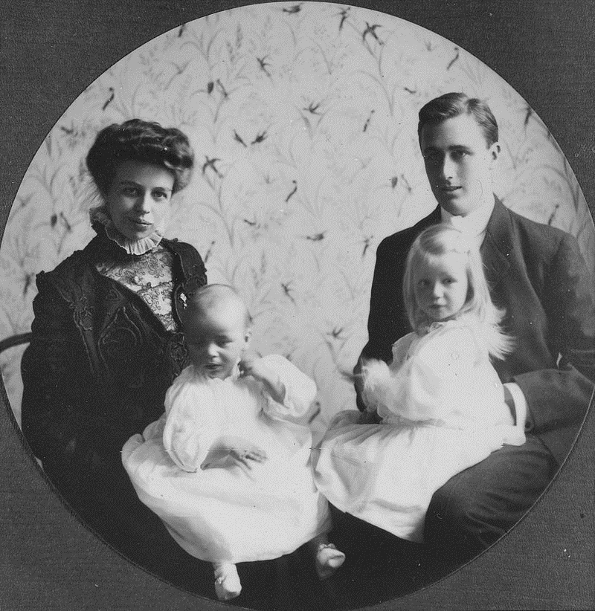
The “arrangement”
Marries cousin Franklin 1905
Eleanor and Franklin 1908
`
Married life…with mother in law
… ‘duty”.6 children..
.marginalised in home
…FDR rising politician..
The affair:1918….discovers letters FDR & mistress..Lucy Mercer…divorce?.
….Sara threatens cut off
FDR paralyzed 1921
…Eleanor nurses him
…”Deal” made
…FDR politics/ Eleanor Social work

Slide 24
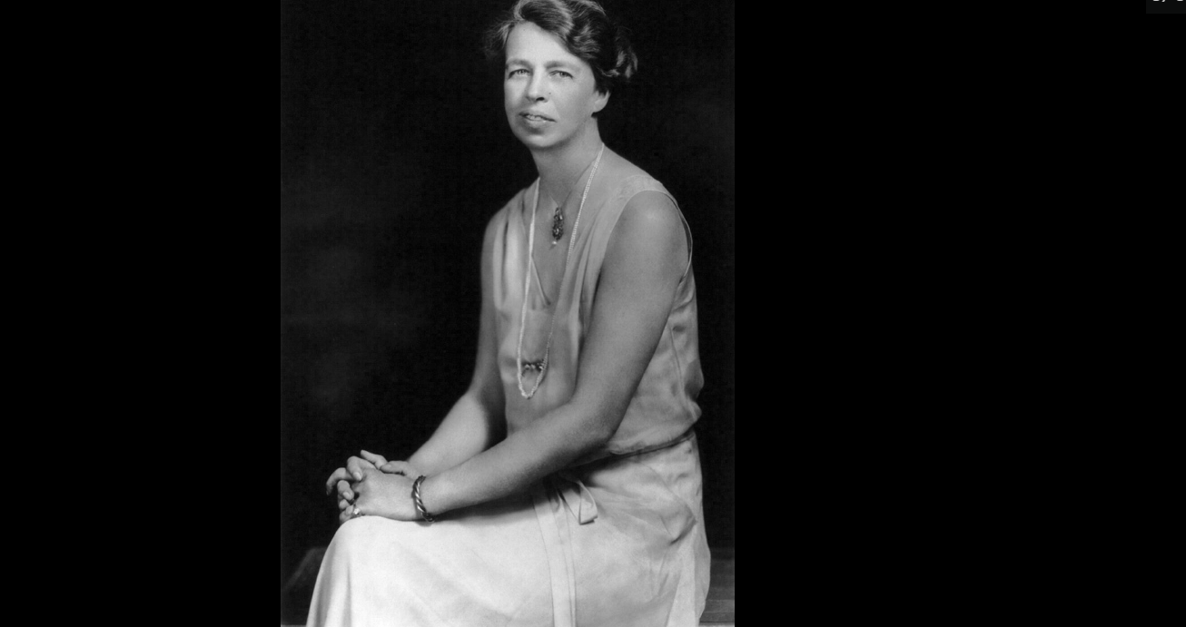
First Lady1933-1945
Expands role ….civil rights agenda
…”eyes and ears”of New Deal
…housing experiments for poor
…sets up and runs charities
Intervenes and advises on issues
…bonus army returns 1935
.. Visits, sings with soldiers,
…persuades FDR to approve payment
“Hoover sent the Army. [President]
Roosevelt sent his wife.“
.
Develops private income
…..girls school
….lecturer, writer
….weekly radio show
Private residence

Slide 25
Eleanor’s home (Hyde Park, New York)

Slide 26
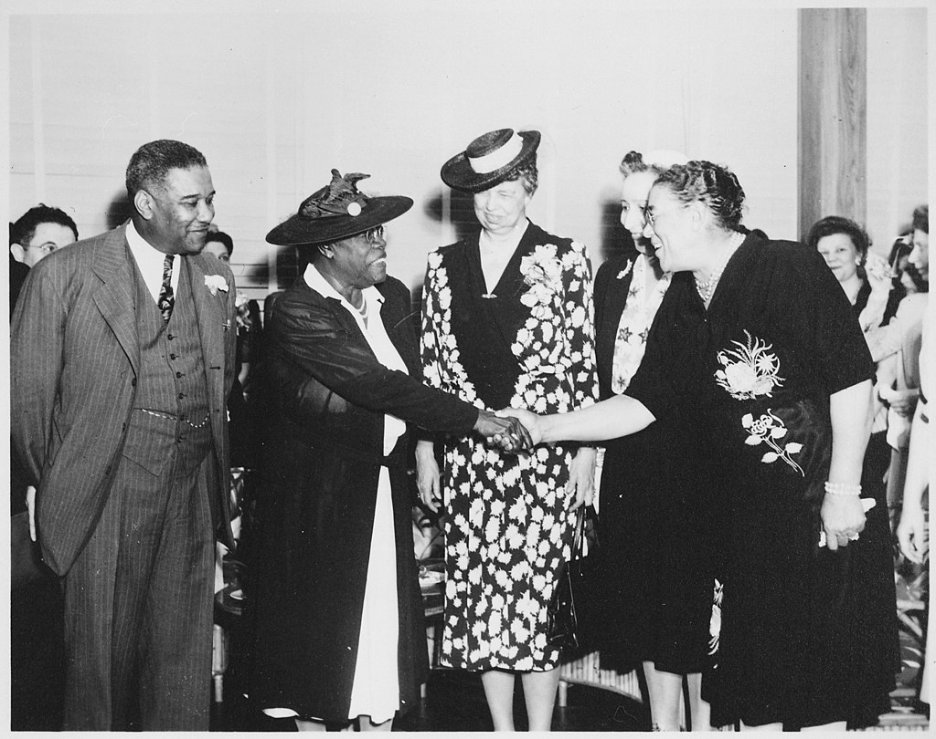
Meeting black politicians…in “White House”

Slide 27
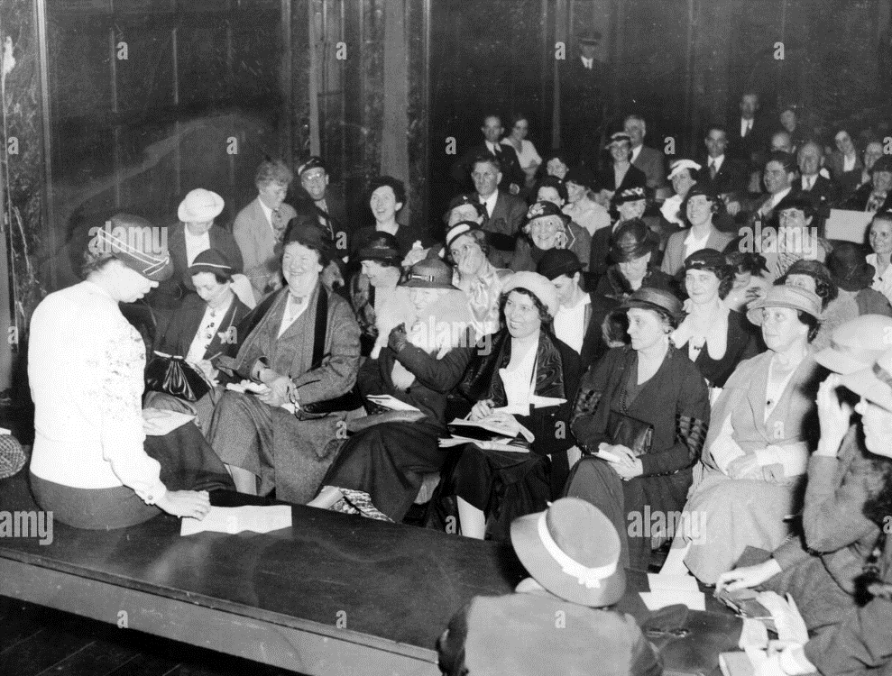
Holds regular press conferences…out and about

Slide 28
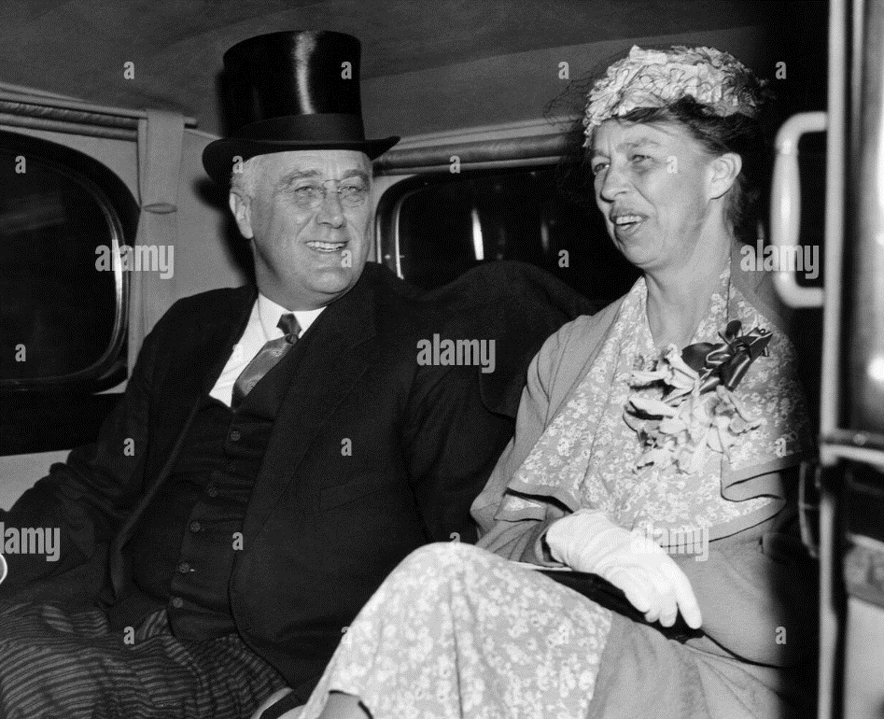
A productive relationship
Separate and together
…separate homes
…public together
…private debates
…discrete private life
….media respectful
Eleanor relationships
….body guard Aron Miller
…leftists/ lesbians
…discrete/ platonic?
FDR –affairs continue
…Lucy Mercer at deathbed
…discrete exits
..Eleanor arrival later

Slide 29
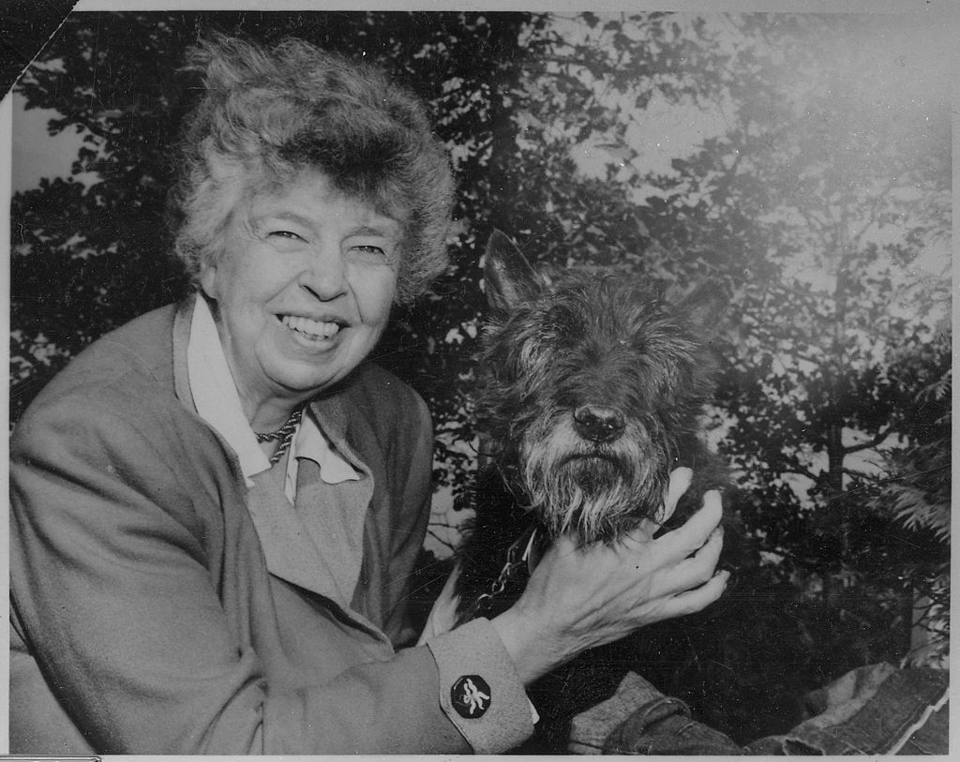
Eleanor….most influential (and loved) First Lady …activist Human rights campaigner rest of life

Slide 30
1938 New Deal appears to be flat
US heading seems stuck in permanent depression
….Unless something big happens
….and it is about to do so in unexpected ways
… next talk US 1930’s and a world at war

